Slide 1
80 Impactful Research Topics for High School Students
By Rebekah Pierce
Educational writer and former teacher
Last updated Mar 4, 2025Published Aug 18, 2024
https://www.polygence.org/blog/research-topics-high-school-students

Slide 2
Technology Research Paper Topics
The Influence of Artificial Intelligence on Modern Society: Artificial Intelligence (AI) is no longer just a concept from sci-fi movies. What are the ethical considerations?
Cybersecurity Threats and Measures in the Digital Age: With the rise of digital technology, cybersecurity is more important than ever.
The Future of Renewable Energy Technologies: Solar panels, wind turbines, and electric cars are just the beginning.
Impact of Social Media on Youth Behavior: Social media platforms like Instagram, TikTok, and Snapchat dominate the lives of teenagers - for better or worse.
The Role of Technology in Modern Education: How are digital tools and online platforms enhancing learning experiences?

Slide 3
Health and Medicine Topics
The Effects of Diet and Nutrition on Mental Health: What we eat doesn't just affect our physical health.
Advances in Cancer Research and Treatment: Explore the latest advances in cancer research.
The Impact of Vaccines on Public Health: Are vaccines safe? What does the future hold?
Mental Health Issues Among Teenagers: For these psychology research paper topics for high schoolers, explore the many factors leading to an increased incidence of mental health issues in teens, from academics to Snapchat and everything in between.
The Role of Genetics in Personalized Medicine: Take a closer look at how genetic studies are being used to create personalized, in-depth treatment plans for patients.

Slide 4
Environment Topics
Climate Change and Its Impact on Global Ecosystems: Climate change is affecting us all. Take a look at how melting ice caps and rising temperatures are impacting ecosystems around the world.
Sustainable Practices in Urban Development: To minimize our environmental impact, we need to think green. But what does this mean for urban development?
The Effects of Pollution on Marine Life: How can we reduce the impact of pollution on marine life?
Renewable Energy Sources: Benefits and Challenges: Renewable energy sources like wind, solar, and hydroelectric power offer numerous benefits but also come with challenges. Explore these.
The Importance of Biodiversity Conservation: How can we incorporate strategies to protect endangered habitats?

Slide 5
Social Issues and Sociology Research Topics
The Impact of Social Media on Interpersonal Relationships: Social media is shaking up the way we interact with others.
The Role of Education in Reducing Inequality: Education is the number one way to reduce inequality. Explore strategies and policies that can help with this.
Gender Equality in the Workplace: Gender equality remains a significant issue in workplaces worldwide - talk about why and how to address this.
The Effects of Poverty on Community Health: Explore how poverty has far-reaching impacts on nutrition, healthcare access, and overall health and well-being.
Immigration Policies and Their Social Implications: Immigration policies are far-reaching, impacting more than just immigrant communities.

Slide 6
Science Research Topics
The Exploration of Space: Past, Present, and Future: What are the scientific and societal benefits of exploring space?
Genetic Engineering and Its Ethical Implications: Are there ethical considerations (or risks) of genetic engineering? Take a look at them.
The Impact of Climate Change on Natural Disasters: Climate change is increasing the frequency and severity of natural disasters.
Advances in Renewable Energy Technology: Renewable energy technology is advancing rapidly - what innovations hold the most promise?
The Role of Science in Solving Global Problems: How can science help solve problems related to disease, poverty, and climate change?

Slide 7
Economics Topics
The Effects of Globalization on Local Economies: Globalization is reshaping economies worldwide -explore its impacts on local businesses and job markets.
The Role of Technology in Transforming the Job Market: From AI to automation, technology is revolutionizing jobs.
Economic Impacts of Climate Change: Climate change isn't just an environmental issue; it's an economic one too.
The Influence of Consumer Behavior on Market Trends: Ever bought something because it was trending? Study how consumer behavior shapes market trends.
The Future of Cryptocurrencies in the Global Economy: Bitcoin, Ethereum, Dogecoin - what's the deal?

Slide 8
Education Research Paper Topics
The Impact of Online Learning on Student Performance: Online learning is more relevant now than ever, which you’ll explore in this education research topic.
The Role of Technology in Modern Education: How are smart boards and tablets changing classrooms for public schools? How can they improve academic achievement?
Comparative Analysis of Education Systems Around the World: Why do some countries excel in education while others lag? Compare different education systems to see what works and doesn’t.
The Effects of Standardized Testing on Student Learning: Standardized tests are controversial; research their impacts on student learning and whether they accurately measure academic performance and predict academic success, particularly related to special education, elementary school, and early childhood education.
Innovations in Educational Methodologies: From flipped classrooms in elementary education to gamification for middle school, explore different teaching methods with this research question.

Slide 9
Athletics Topics
The Impact of Sports on Academic Performance: Do athletes perform better academically?
The Role of Athletics in College Admissions: Sports can be a ticket to higher education. Research how athletics influence college admissions and scholarships for current college students.
The Effects of Physical Activity on Mental Health: Exercise isn’t just for the body; it’s also for the mind. Explore that in these research ideas.
The Influence of Sports on Leadership Skills
Sports teach more than physical skills. Analyze how participation in sports cultivates leadership qualities.
The Future of Technology in Sports Training: From wearable tech to virtual reality, technology is revolutionizing sports training.

Slide 10
Society, Culture, and Social Science Topics
The Effects of Social Media on Cultural Norms: Social media is changing culture. Research its impacts on cultural norms and behaviors.
The Role of Tradition in Modern Society: Traditions persist in modern times. Study the role of ancient traditions in contemporary society.
Comparative Analysis of Cultural Practices Around the World: Different cultures, different practices. Compare cultural practices and their meanings worldwide.
The Influence of Media on Public Perception: Media shapes how we see the world.
The Impact of Globalization on Cultural Identity: Globalization is blending cultures. Research its effects on cultural identities.

Slide 11
Business and Entrepreneurship Topics
The Impact of Startups on the Economy: Startups are economic powerhouses. Study their impacts on local and global economies.
The Role of Innovation in Business Success: Research how innovation influences business achievements.
Ethical Considerations in Business Practices: Investigate ethical considerations and their impacts on business practices.
The Influence of Digital Marketing on Consumer Behavior: Analyze the effects of digital marketing on consumer behavior and purchasing decisions.
Strategies for Successful Entrepreneurship: Want to start a business? Explore strategies.

Slide 12
10 Famous Brands that Depend on Market Research
1. Starbucks Coffee Company
2. Apple Inc.
3. McDonald’s Corporation
4. The LEGO Group
5. Dove
6. Zappos
7. Coca-Cola
8. Procter & Gamble (P&G)
9. Amazon
10. Netflix

Slide 13
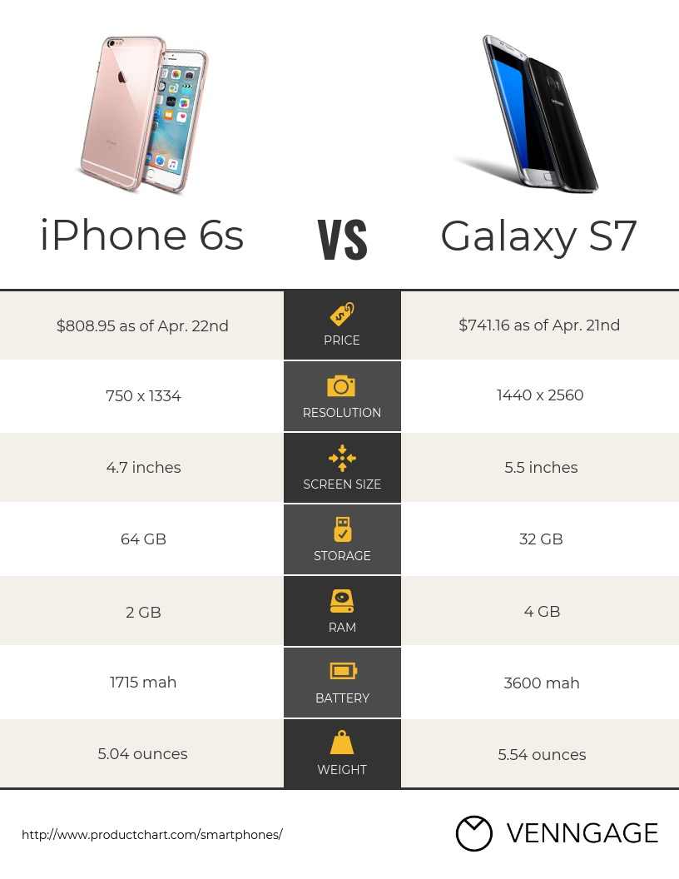

Slide 14


Slide 15
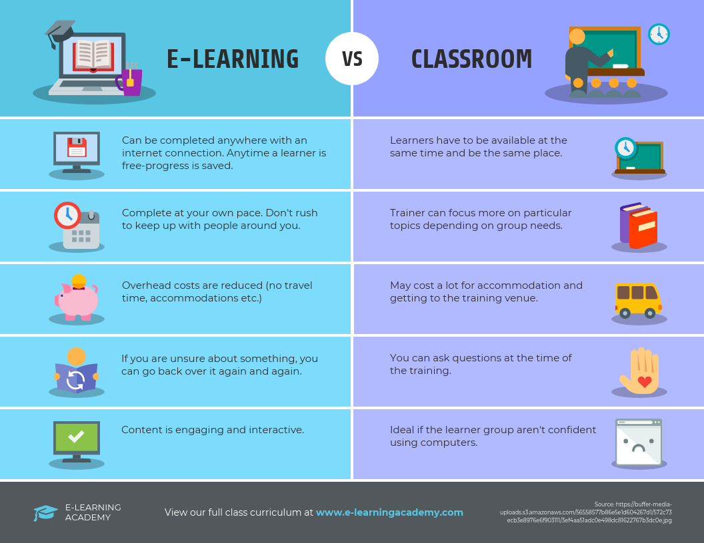

Slide 16
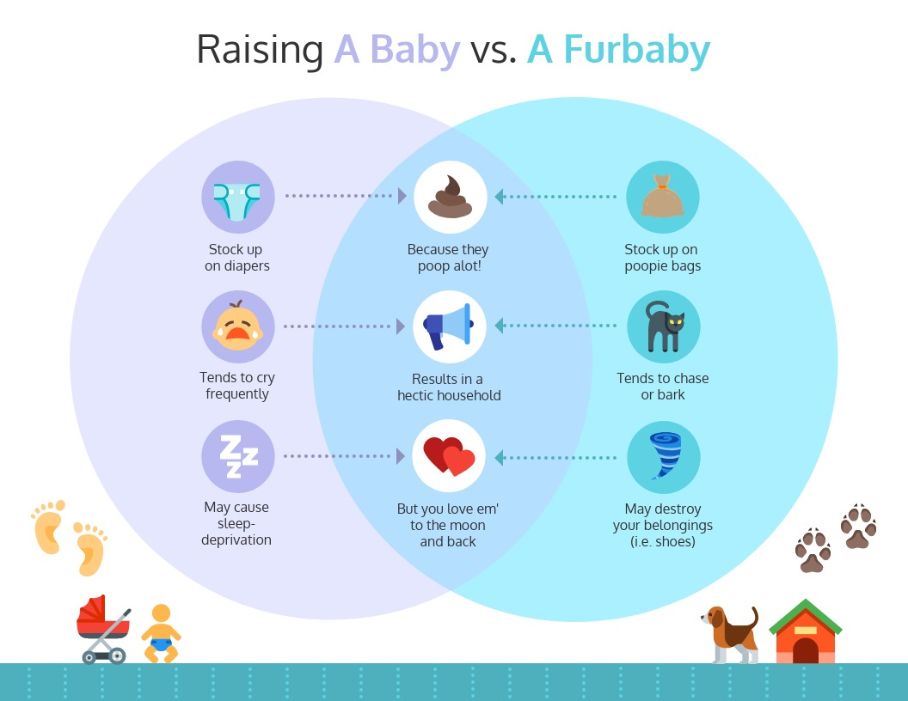

Slide 17
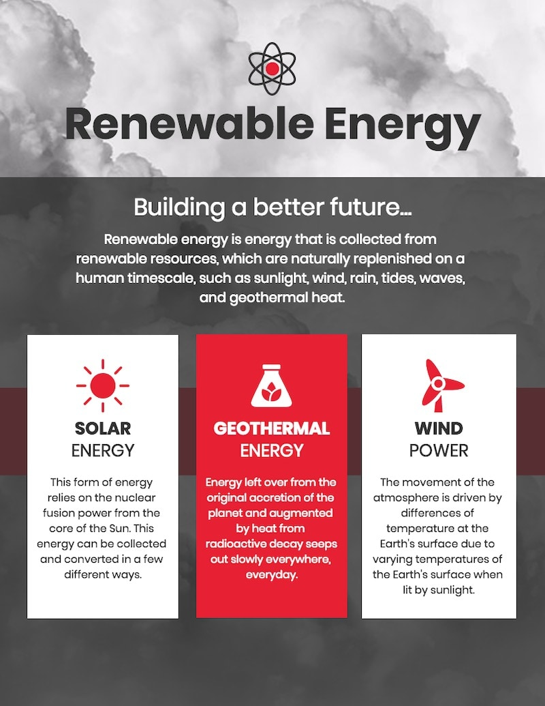

Slide 18
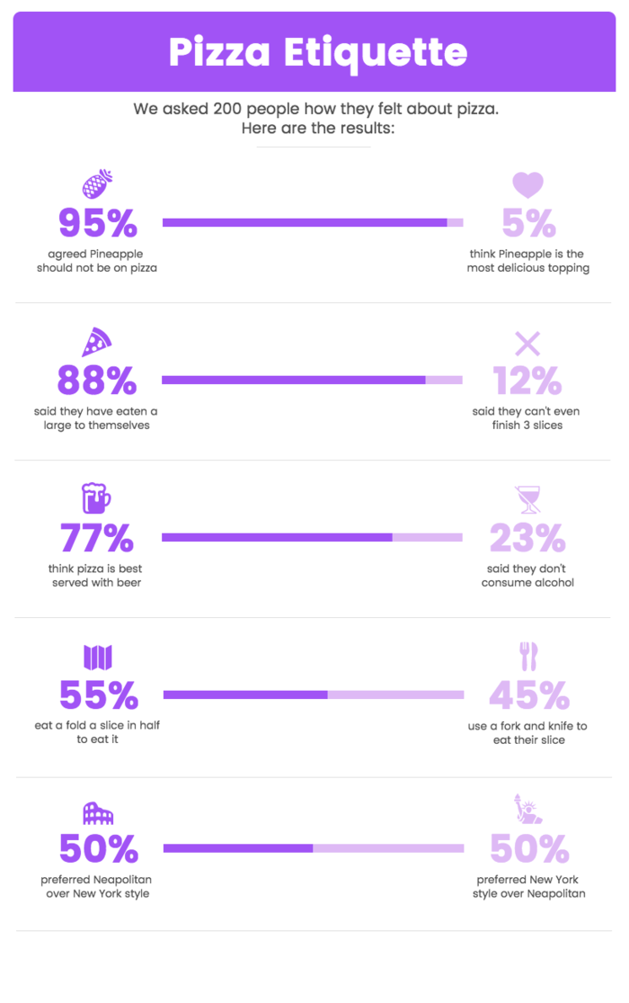

Slide 19
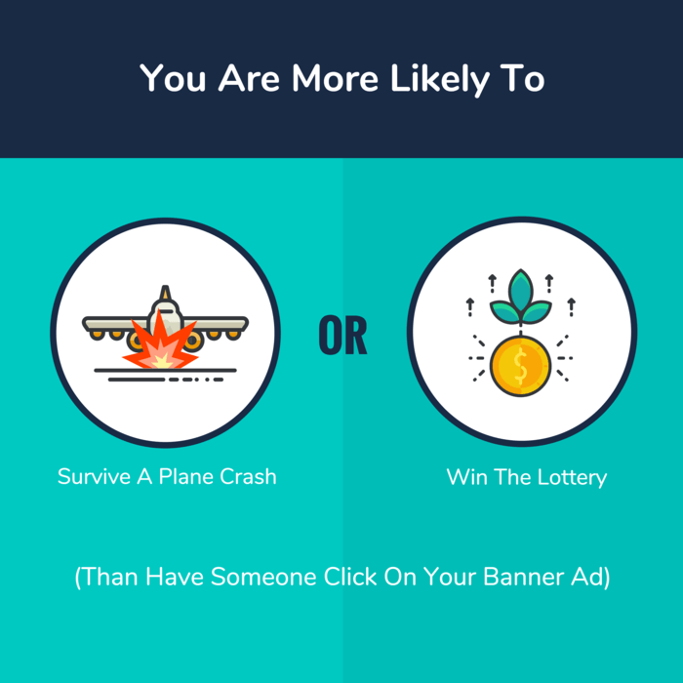

Slide 20
